Slide 1


Module 3: Backend – advanced Workflow Execution
Developing Business Applications with

Slide 2




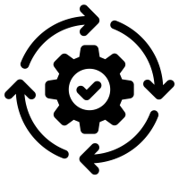



Browser
Module 3: Backend – advanced (jobs & workflows)
Client
WebSocket
Application Services
HTTP
HTTP
Authorization
Server
Web
Server
Job
Orchestrator
Job
Host(s)
Job
Host(s)
HTTP
Job
Host(s)
HTTP
TCP/IP
TCP/IP
HTTP
HTTP
Infrastructure Services
Azure
PostgreSQL
MIKE Cloud
Services

Slide 3

Purpose of the Workflow - History
Architecture
Workflow Example
Building blocks – Actions
Scenarios
Notes:
<use this slide for agenda>

Slide 4

Who Am I
Franz Thomsen - Head of Port IT / Cybersecurity, Seaport OPX
With DHI since 2001 - first operational systems in 2003
Lots of front-ends through multiple tech stacks
Lots of backends through multiple tech stacks, supporting frontend
Backend “async” scenario/workflow systems since 2009
Reusable, Reusable, REUSABLE
Notes:
<use this slide for agenda>

Slide 5
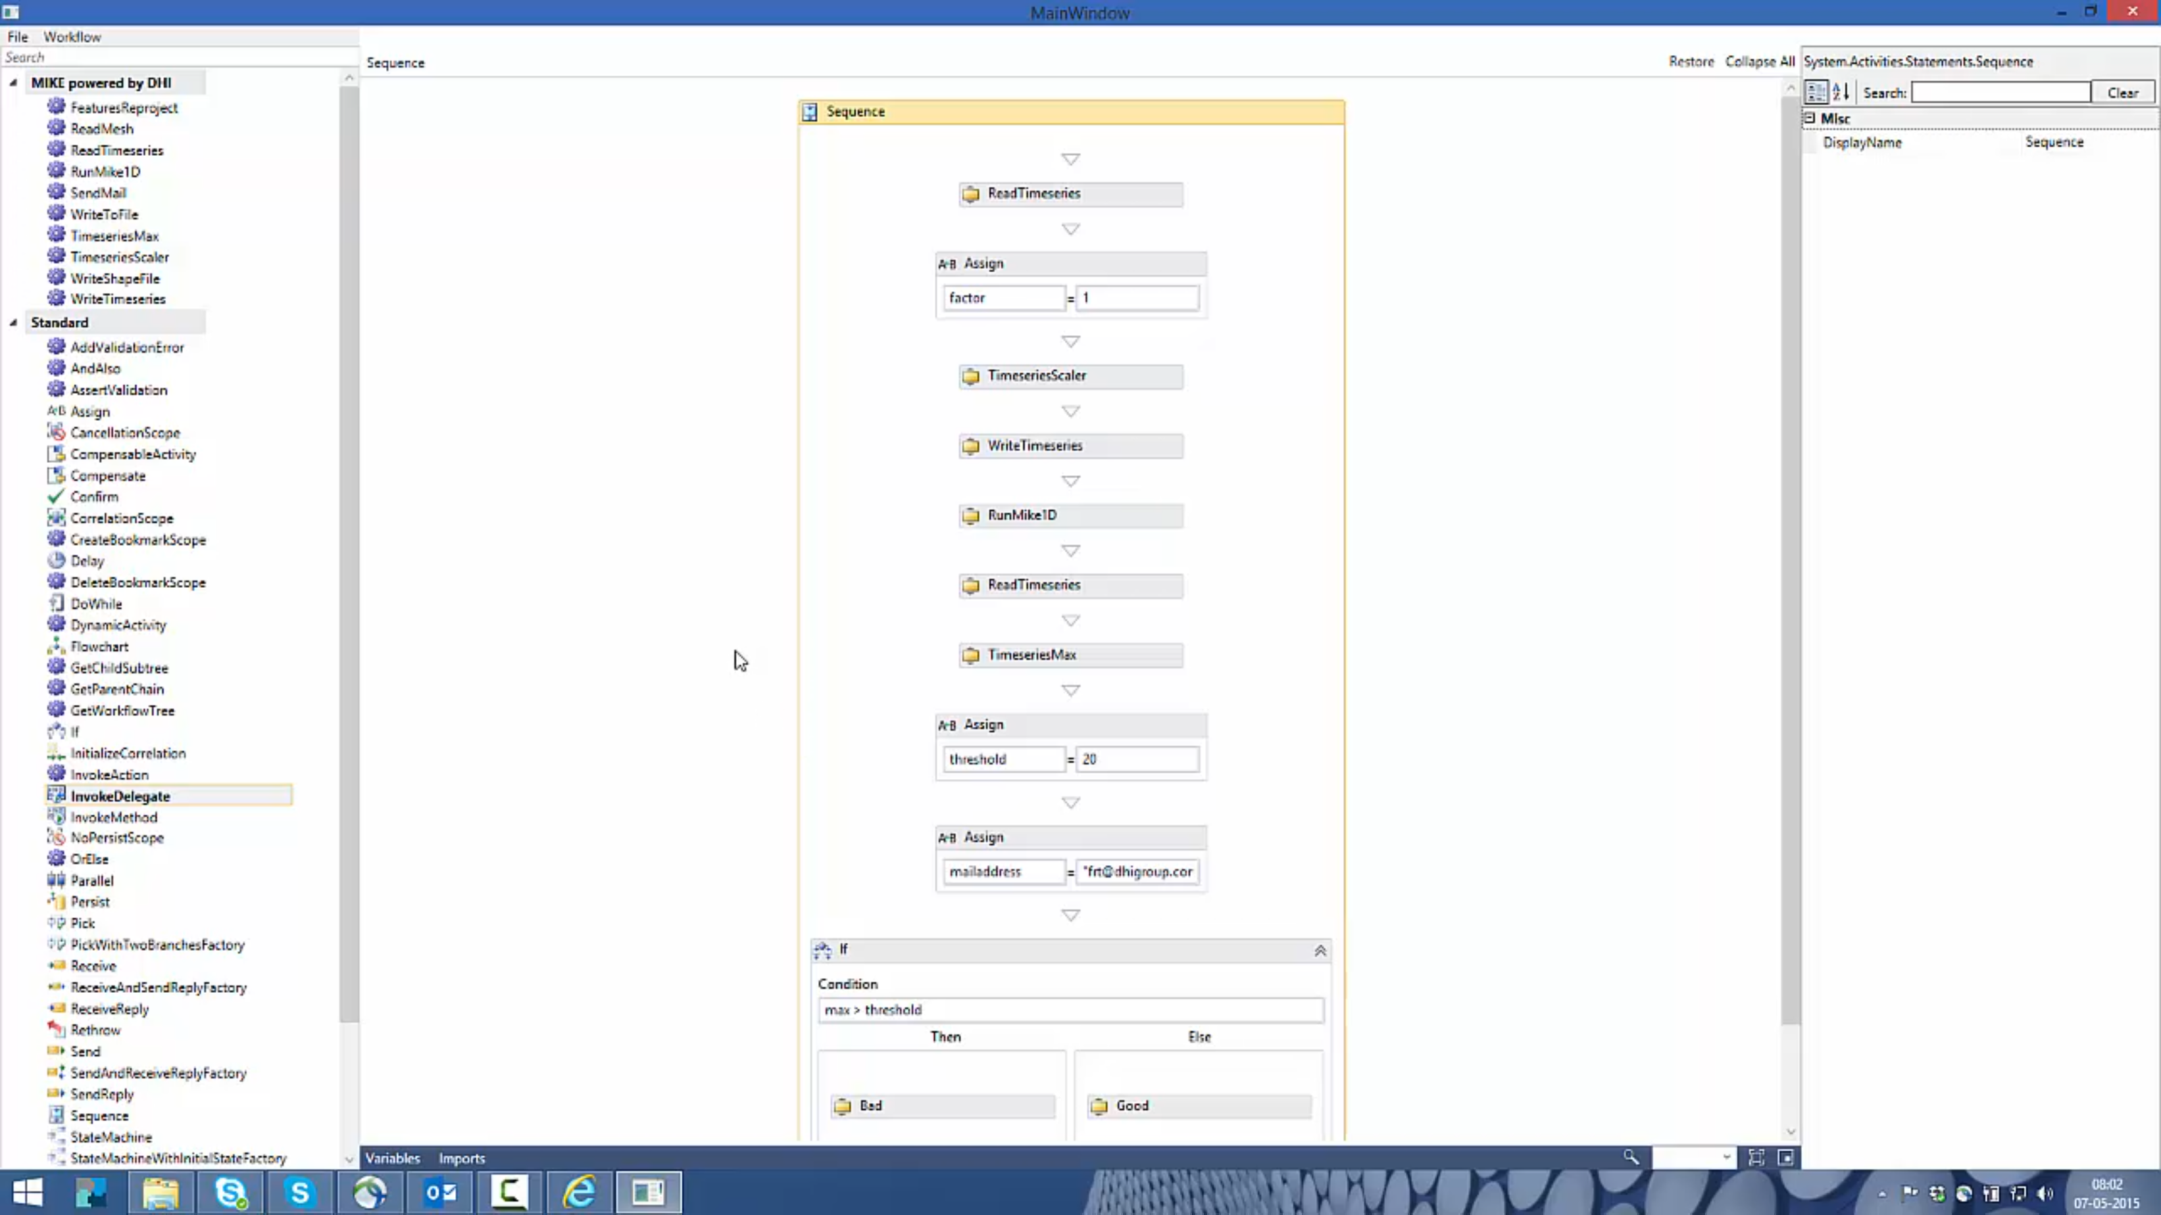
History – 2015 Windows Workflow Foundation is amazing
Reusable building blocks that snaps together through Code Activities
Designer through Windows Workflow Foundation
Xaml based workflows
Domain Services as pillar
Notes:
<use this slide for agenda>

Slide 6
History – 2021 Windows Workflow Foundation is going out, no .net core support
Reusable building blocks that snaps together through Actions (code from Code Activities moved to Actions)
No designer, Visual Studio is used
C# based workflows
(This is where we are now)
Notes:
<use this slide for agenda>

Slide 7
Beyond A designer just makes things very accessible for everyone – ELSA?
Reusable building blocks that snaps together through ELSA Activities wrapping Actions
Web based designer
Json based workflows
Notes:
<use this slide for agenda>

Slide 8
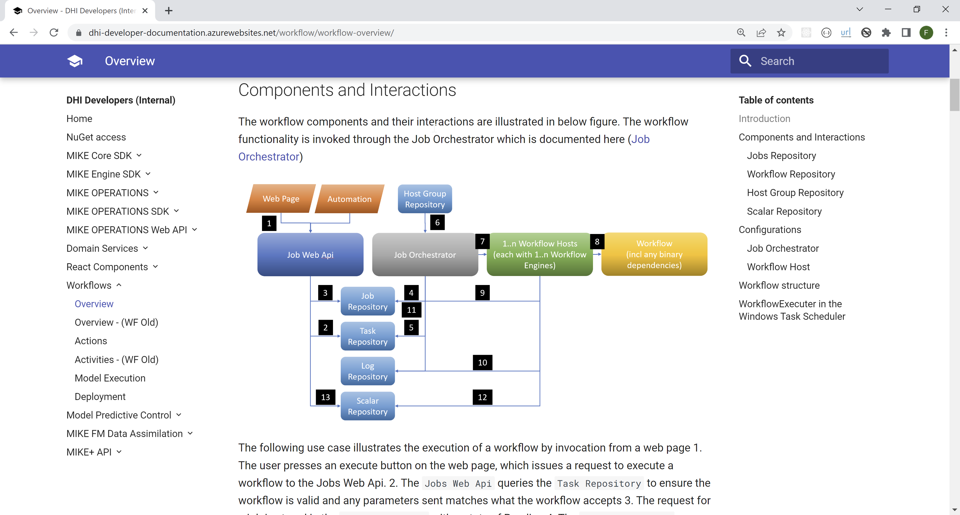
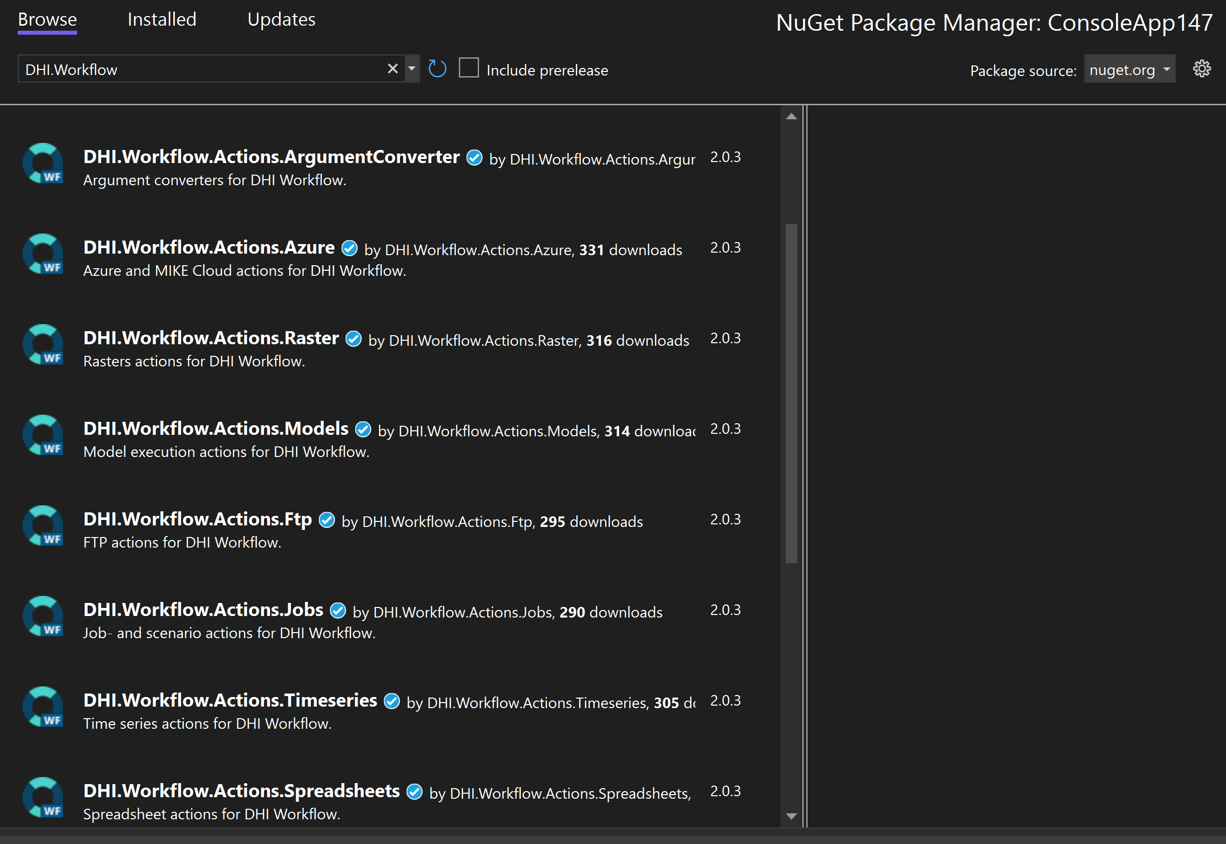
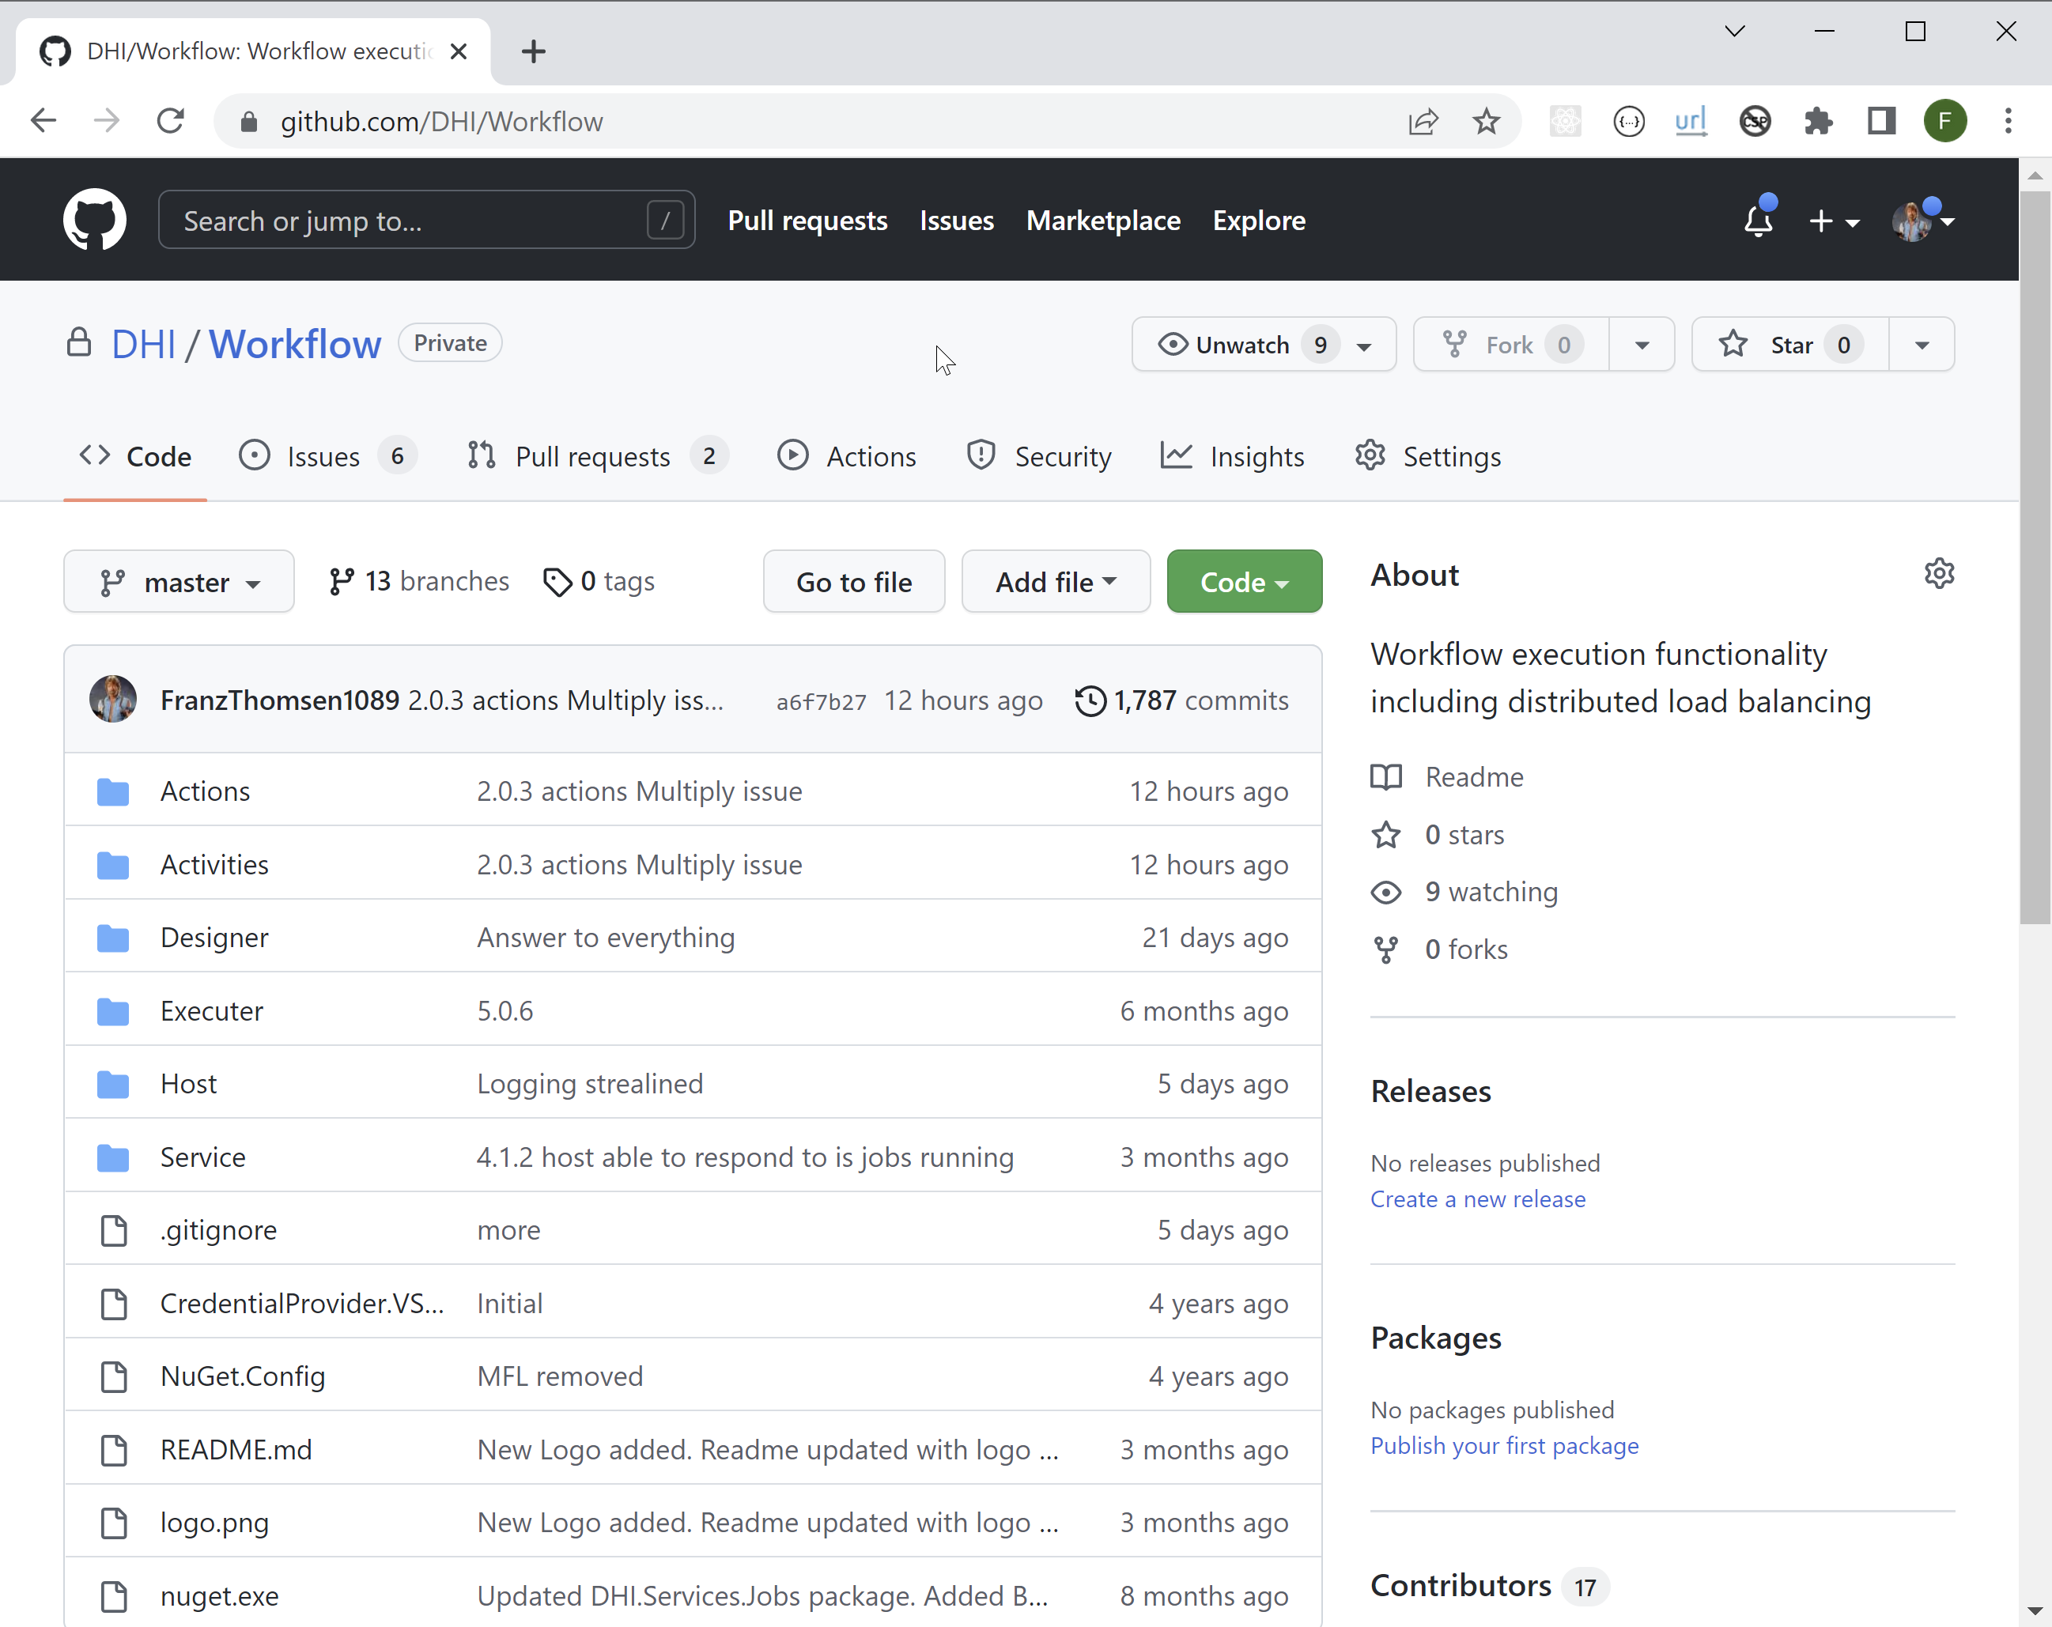
Resources
Developer Documentation
For packages, NuGet
For source, GitHub
Notes:
<use this slide for agenda>

Slide 9
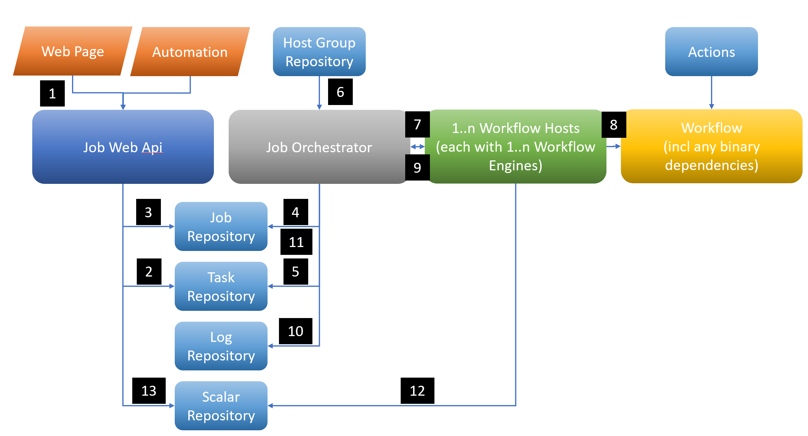
Architecture
Notes:
<use this slide for agenda>

Slide 10
Architecture
Job Repository: Where jobs are tracked with status, completion times etc
Task Repository: The workflows or a representation of these
Log Repository: Where logs go through
Host Group Repository: Registry of hosts to use VMs, ScaleSets, containers
Scalar Repository: A collection of individual values like health flags, other KPIs
Job Orchestrator: The mechanism delegating jobs to execute workflows to available hosts
Workflow Host: The mechanism on the VM, ScaleSets, container that execute the workflow
Workflow: The C# workflow that YOU build
Actions: The prefabs that you can base the Workflow on
Notes:
<use this slide for agenda>

Slide 11
Architecture
Notes:
<use this slide for agenda>

Slide 12
Example Workflow
Notes:
<use this slide for agenda>

Slide 13
Going forward
New designer?
Hybrid Execution option, Azure <-> On Prem/Data Centre
Workflow Host integration with Azure Artefacts
Kubernetes integration
Job Automater, scheduling and event based start of jobs
Notes:
<use this slide for agenda>

Slide 14

Notes:
<use this slide for breaks>

